Slide 1
Continuing professional development (CPD) Week -2- Personal practice development)

Slide 2
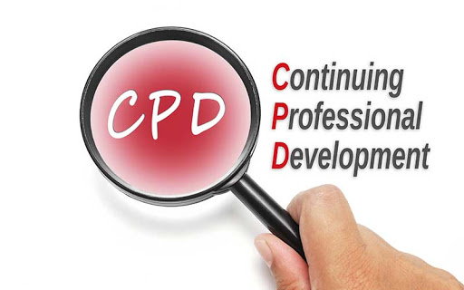
Module lecturer-Tayo Alebiosu
Health and Social Care
Evidence Based Approaches
Contact me: tayo.alebiosu@lsclondon.co.uk

Slide 3

Last session recap (10 minutes)
Individually,
What is Continuous Professional Development?
What is Continuous Professional Development in healthcare sector?
Feedback to the class

Slide 4

Aim;
Analyse personal practice developments that are responsive to changing needs of the sector.
Learning outcomes At the end of this lesson students will be able to ;
Analyze personal practice developments that are responsive to changing needs of the sector
Highlight the potentially significant contribution of personal practice developments to the health care sector.

Slide 5
Several different types of learning count as CPD activities
Identify the tools of CPD highlighted by healthcare practitioners in the below video.
CPD activities
Feedback to the class
https://youtu.be/mTVaxM3Fum4
Any activity from which you learn or develop professionally can be considered eligible for CPD, though you should ensure that these complement your practice and enhance the service you provide.

Slide 6
Popular tools like SWOT and PEST Analysis, and techniques like setting SMART goals, are all part of it. When you use these to think about your own development, you will come away with a thoughtful and well-considered roadmap that you can use to reach your career goals.
Tools for CPD

Slide 7
Continuing your learning
As a health or social care worker, it is important to carry out further training and qualifications.
Continuing professional development, (CPD), is a record of your learning, development and achievement. It will usually be in a folder which keeps records of your progress beyond your initial training.
The PDP will help you to focus on areas for learning and development. Continual learning is needed by all workers, especially in health and social care as changes happen regularly.
For example, legislation may change, ways of working may be developed and ways to complete documentation may be improved. Your CPD file will become valuable evidence of what you have done to develop your knowledge and skills.

Slide 8

LO1 Activity (5 MINUTES)
What is practice development in health and social care?
Feedback to the class

Slide 9
What is Practice Development (PD)?
The term practice development covers a wide range of activities, including the introduction of changes in practice, the support and development of practitioners, setting standards and quality improvement
PD is a continuous process of developing person-centred cultures.
The learning that occurs, brings about transformations of both at the individual and team level and not just at the wider organisational level.
This is sustained by transforming the contexts and cultures in which nursing takes place.
Provides a systematic approach of effective and sustained changes in practice.
Continuous PD approach is required to effect change.
When applied, PD effects are both relevant to staff and patients.

Slide 10
Practice Development
Professional practice is defined as practice that reflects the commitment to caring relationships with patients and families and strong ethical values; utilization of specialized knowledge, critical inquiry, and evidence-informed decision making; continuous development of self and others; accountability and responsibility for insightful competent practice;
Example of Professional practice
The goal of professional practice at ABC Health Services is to have: Caring, competent, committed healthcare professionals collaborating to create quality outcomes and positive patient and family experiences

Slide 11
Professional practice
Professional practice is defined as practice that reflects the commitment to caring relationships with patients and families and strong ethical values;
Utilization of specialized knowledge, critical inquiry, and evidence-informed decision making;
Continuous development of self and others; accountability and responsibility for insightful competent practice;
Demonstration of a spirit of collaboration and flexibility to optimize service.

Slide 12
Person centred care
Person-centred care is a way of thinking and doing things that sees the people using health and social services as equal partners in planning, developing and monitoring care to make sure it meets their needs.
This means putting people and their families at the centre of decisions and seeing them as experts, working alongside professionals to get the best outcome.

Slide 13
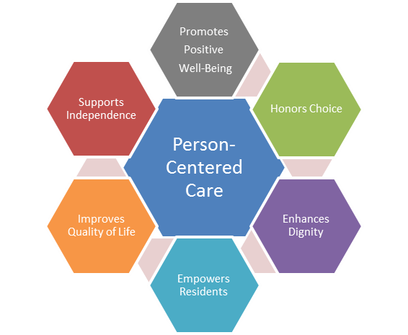

Slide 14

Activity
Complete the activity sheet what do these mean to you?
Respect
Individuality
Rights
Privacy
Independence
Choice
Dignity
Partnership

Slide 15
Duty of Care
Duty of Care
Completion of all tasks to the highest standard
Application to all areas of professional practice
All staff have a responsibility for the safety of the service users
Adhering to codes of practices and legislation

Slide 16

Respect
Respecting someone means believing and showing that they have importance as an individual.
It means that they have their own opinions and feelings and that even though you may not agree with them, you do respect them.

Slide 17

Dignity
Treating somebody in a dignified way means to treat someone with respect, valuing their individuality and their ethical and moral beliefs.
In order to provide the dignified care, you need to have an open and positive attitude.
Take time to do things their way, don’t make assumptions about how they want to be treated and be aware of how personal care may affect their dignity.
Health and social care workers must protect the dignity of each individual by being aware of situations and actions that could cause embarrassment and make the individual feel silly or exposed.

Slide 18

Choice
Each individual should be supported to make choices about their care and support.
They should be given information in a way that they can understand so they can make informed choices.
When working with individuals who cannot express their wants, needs and wishes in words, you must find other ways of communicating. Additional training and supervision can help you to develop these skills.

Slide 19
Rights
You should make sure an individual’s rights are respected, not only by yourself but by other people involved in their care.
It means that they have their own opinions and feelings and that even though you may not agree with them, you do respect them.
You have the right to speak your mind and be kept safe from harm, as well as the right to respect dignity and equality.

Slide 20
Confidentiality
Confidentiality means not sharing information about someone without their knowledge or consent and ensuring that written and electronic information cannot be accessed or read by people who have no right to see it!
Information should only be shared on a ‘needs to know basis’.

Slide 21

Independence
Promoting an individual’s independence means to look at what they can do for themselves and empower them to do as much as possible for themselves. It does not mean leaving someone to cope alone but agreeing to the support they need and want.
Supporting clients to do things for themselves rather than doing things for them prevents them from developing ‘learned helplessness’ where someone becomes dependent on carers even though they are capable of doing things for themselves.

Slide 22
Professional practice
Professional practice is defined as practice that reflects the commitment to caring relationships with patients and families and strong ethical values; utilization of specialized knowledge, critical inquiry, and evidence-informed decision making; continuous development of self and others; accountability and responsibility for insightful competent practice;
The goal of professional practice at ABC Health Services is to have: Caring, competent, committed healthcare professionals collaborating to create quality outcomes and positive patient and family experiences

Slide 23

“Practice development is a continuous process of improvement towards increased effectiveness in person centred care, through the enabling of nurses and healthcare teams to transform the culture and context of care.
It is enabled and supported by facilitators committed to a systematic, rigorous continuous process of emancipatory change.” (McCormack et al., 1999. pg. 256).
Practice development is defined as a facilitated process that aims to promote person- centred and evidence-based healthcare. Practice development seeks to engage individuals at all levels of an organisation in order to create positive change.

Slide 24
Practice development has been used in numerous ways to enhance clinical services, such as:
To increase quality and safety in healthcare within a unit,
To develop shared values and service priorities and to improve communication within a healthcare team (McCormack, 2010 ; McCormack et al., 2013).
Practice development is described as a mechanism for reflection about everyday practice, enabling those who deliver care to make changes to facilitate better clinical outcomes and improve the quality and safety of care

Slide 25
“Transformational culture” and quality becomes everyone’s business.
Moving from service-centred moments to person-centred care.
Improves patient care.
Changes culture of care (engagement, autonomy and connected).
Translating research into practice (evidence based care).
Continuous improvement and systematic changes.
Valued competencies.
Evidence based practice and knowledge translation.
Promotes and facilitates change.
Well-being for staff and patients- the organisation hold the same process for both.
Allow people to flourish and grow.
Provides audit and quality measures.
What is PD about?

Slide 26
Practice Development and the Workplace
The practice development approach, links clinician-led innovation to the context of the workplace. The organisation (local and wider) may adopt this approach as a means to quality improvement of ‘practices’ which will lead to the development and implementation of evidence-based practice policies and influence strategic vision.
It also offers clinicians the opportunity to critically evaluate and evolve their workplace practices and their practice culture while taking into account the organisational context of their work. Practice development has strong links with methods of workplace learning and communities of practice theories.

Slide 27
One of the primary goals of practice development is ‘to shift the focus of activity to the client’
As a result, person-centred cultures and workbased learning are also key elements of practice development
In this context, person-centredness is defined as ‘an approach to practice established through the formation and fostering of healthful relationships between all care providers, service users and others significant to them in their lives’
Benefits

Slide 28
Why is professional practice important?
An environment that supports professional practice is arguably the most important factor to achieve better staffing, better patient outcomes, and higher staff and patient satisfacti

Slide 29
Enables the healthcare team to transform culture and care.
Increased staff satisfaction.
Increased staff retention and recruitment.
Builds culture and shared values.
Develop skills and knowledge of staff.
Team engagement.
Delivers person centred care.
Benefits

Slide 30
Practice development key characteristics
It focuses on the improvement of patient care
It incorporates a range of approaches
It takes place in real practice settings
It is underpinned by the development and active engagement of practitioners
It is collaborative (e.g. multi disciplinary teams)
It is always developing

Slide 31

How personal development works?
There are a number of steps in personal development.
Step one is to think about the demands of your job –
Its purpose, how the tasks listed in your job description relate to that purpose and, most importantly, what it means to do the job well. Ask yourself what knowledge, skills and attitudes are required to do your job well.
Step two is to reflect on and evaluate your own performance.
Identify the parts of the job that you enjoy – and the parts you find difficult. How fully do your knowledge, skills and attitudes match those that the job requires? How could you improve your ability as a care worker?
Step three is to agree a personal development plan with your line manager.
The plan says what knowledge, skills and attitudes you aim to develop and how you will develop them. Step four is to carry out the learning activities in your plan – and then evaluate the results. What new knowledge and skills have you gained? How has this improved the way you work?

Slide 32
Action Step | Step
1. Make a note of what you have learned and how it has helped you at work | Step 4
Understand your organisation’s system for recording personal development.
3. Decide on your learning goals.
4. Consider the ways you learn best.
5. Find out what standards and qualifications relate to your job.
6. Check that you have the communication and number skills your role requires.
7. Identify sources of support for your personal development.

Slide 33

There are many learning activities that you can take part in to help your career such as:
On-the-job learning
Courses and workshops
Volunteering
Computer-based learning
E-learning

Slide 34

Put another way, it's about where you are, where you want to be, and how you plan to get there.
There are many learning activities that you can take part in such as:
on-the-job learning
courses and workshops
volunteering
computer-based learning
It goes on to explore self-reflection, getting feedback and completing learning activities as well as the importance of a Personal Development Plan.

Slide 35
E-portfolio
An e-portfolio allows you to store and record a collection of evidence to demonstrate the skills you have developed. It is useful for:
keeping all your relevant documents together
reflecting on your learning
recording your career planning in your personal development plan (PDP)
preparing for applications and interviews
Find out more about developing a portfolio.
A new development in CPD focuses on monitoring individual daily learning activities. By use of personal portfolio or log-book for registration of CPD activities, and by comparison with similar results of colleagues, a tool is provided for planning an individual self-directed learning or for managing individual development. Doctors accountable to society must thus find means – such as realistic monitoring and documentation of CPD activities - to prove that they are capable of effective practice.

Slide 36
Your regulatory body
If you work in a role that requires registration with a regulatory body in order to practise, such as nursing, then you'll usually be required to keep your skills and knowledge up to date through CPD.
You can find out what the requirements are from the relevant regulatory body responsible for your profession.
Professional bodies provide advice, support and opportunities to enable you to maintain your CPD. The Chartered Institute of Personnel and Development has more information about CPD, including tools to help you record your CPD.

Slide 37

Summary of today’s lesson
In this session:
All / most learners were able to:
Analyze personal practice developments that are responsive to changing needs of the sector
Highlight the potentially significant contribution of personal practice developments to the health care sector.

Slide 38
AN EXPERIENCE/ SCENARIO/TASK / ACTIVITY
REFLECTED
SWOT-STRENGHTS, WEAKNESS, OPPORTUNITIES AND THREATS
PERSONAL DEVELOPMENT PLAN / CPD
SMART- SPECIFIC, MEASURABLE, ACHIEVABLE. REALISTIC and TIME BOUND

Slide 39
Reference
https://nursekey.com/an-overview-of-practice-development/
https://www.healthcareers.nhs.uk/career-planning/developing-your-health-career/personal-and-professional-development/continuing-professional-development-cpd
Read more at: https://www.skillsyouneed.com/ps/areas-of-personal-development.html

